Slide 1


Presented By:
Rakiba Akter
ID:11809031
Dept: ICT
Comilla university
Presented To:
Md.Imran Hossain
Assistant professor
Department of ICT
Comilla university

Slide 2

AM(amplitude modulated) receiver
Outline:
Defination
Rquirement of a AM receiver
Working function of AM receiver with block diagram
Advantage of AM receiver

Slide 3
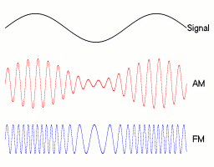
AM receiver:
The AM super heterodyne receiver is the receiver which takes the amplitude modulated wave as an input and produces the original audio signal as output.

Slide 4
Requirement of a AM receiver:
Should be cost-effective
Should receive the corresponding modulated waves
Receiver should be able to tune and amplify the desired signal
Modulation has to be done

Slide 5
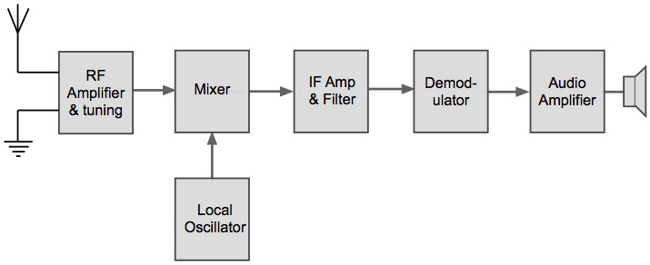
Working function of AM receiver with block diagram

Slide 6
RF Amplifier:
Selects required signal
Rejects other signal
Reduces effects of noise
Mixer:
Receive two input signal(f0>fs)
Mixes these two signals
Generates signals: fs, f0,(fo+fs),(f0-fs)
IF Amplifier:
Selects low freuency signal (f0-fs) is called intermediate signal
Provides gain to the receiver

Slide 7
Demodulation:
The demodulation demodulate the IF signal and then send to audio amplifier.
Audio Amplifier:
This is power amplifier amplify detected audio signal. Then passed to the loudspeaker .

Slide 8
Advantage of AM receiver:
No variation in the bandwidth
High sensitivity and selectivity
High adjacent channel rejection
Greater gain

